Slide 1
Database Access
Adrian Streitz, Johannes Rank, Borys Levkovskyi

Slide 2
Prerequisites
Experience with ABAP Workbench and Eclipse
Basic ABAP programming skills

Slide 3
Agenda
Data dictionary
SAP flight example
SAP OpenSQL

Slide 4
I. Data dictionary What is the data dictionary?
Data dictionary = global directory for data types
Assignment of help texts and explanations for data types in different languages
Entity–relationship model can be shown as a figure automatically
Most important objects: structure, table, data element and domain

Slide 5
I. Data dictionary Hierarchy
Technical attribute (e.g. field length or data type)
Domain
ZY_ID
INT4
Data type
Data element
ZY_ID
ZZ_ID
Field
ZY_ID
ZZ_ID
Semantic attribute (e.g. field label)

Slide 6


I. Data dictionary Hierarchy
Structure
Table

Slide 7
I. Data dictionary Working with the data dictionary
Menu path: Tools • ABAP Workbench • Development • Dictionary
Transaction code: SE11
View, edit, delete, create tables, data types, domains definitions etc.
Tables and views from the ABAP dictionary represent tables and views from the database
User interfaces are generated automatically when changing views, tables etc.
Table may be changed after they are created without losing data

Slide 8
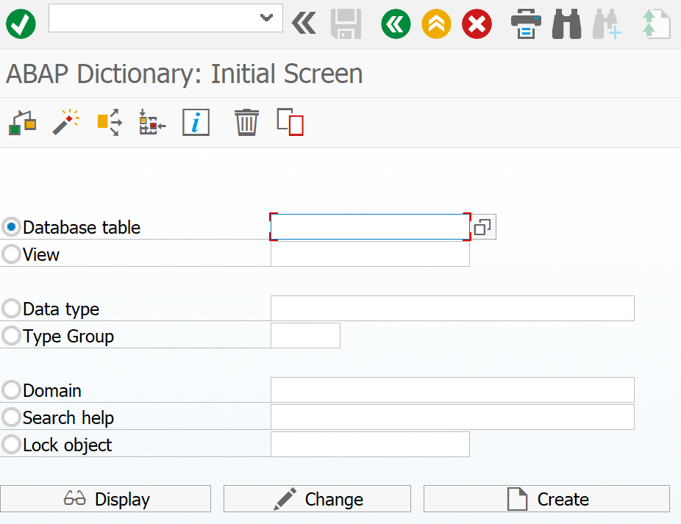
I. Data dictionary Overview about all objects
Database table
View
Data type
Data element
Structure
Database table
Table types
Views
Class / interface
Type group
Domain
Search help
Lock object

Slide 9
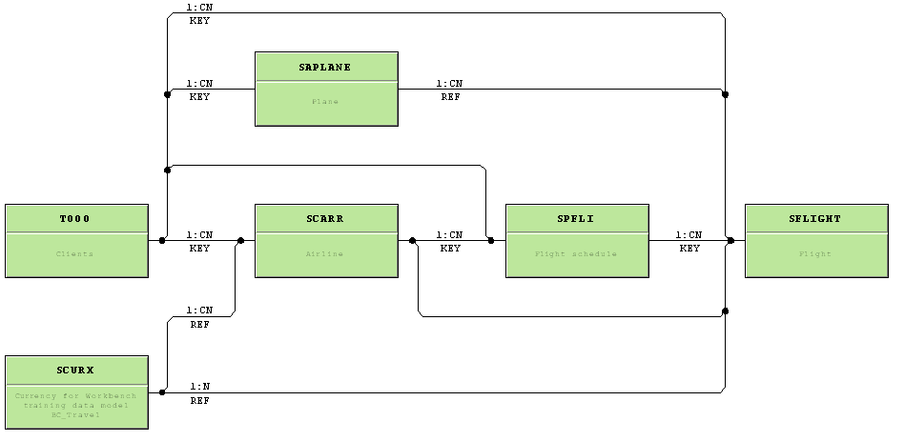
I. Data dictionary Visualization
Foreign key relationships can be visualized in data dictionary
Table SFLIGHT

Slide 10
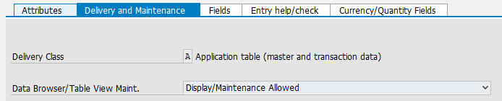
I. Data dictionary Data browser
Menu path: Tools • ABAP Workbench • Overview • Data Browser
Transaction code: SE16
View table content
Add new entries to tables when adding is permitted for the table
It is possible to deny adding entries to a table. To verify if it is allowed please look at the delivery and maintenance settings in the data dictionary.
Browse the entry help table content
Copy table content to transport request
Download table content

Slide 11
I. Data dictionary Enhancement category
Enhancement categories allow to limit future customization of tables
Can be enhanced (Deep) - The structure or table can have any datatype field and deep structures (e.g. table within table)
Can be enhanced (character-type or numeric) - You can have only flat data type fields no deep structures possible
Can be enhanced (character-like) – You can have only character type fields
Cannot be enhanced - The structure can not be enhanced.

Slide 12

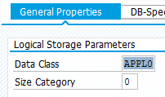
I. Data dictionary Technical settings: Data Class
SE11 ->
APPL0 (master data): data that is rarely changed, but frequently read
APPL1 (transaction data): data that is frequently changed
APPL2 (organizational data): data that is defined when the system is installed and rarely changed

Slide 13
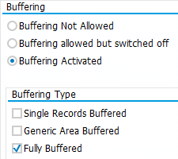
I. Data dictionary Technical settings: Buffering
SE11 ->
Buffering: make data available in memory, so request for the same data can be processed faster
Full buffering: Load all records of the table in the buffer, when one record is accessed
Generic buffering: When a record of the table is accessed, all the records that have this record in the generic key fields are loaded in the buffer
Single-record buffering: Only the records of a table that are really accessed are loaded into the buffer

Slide 14
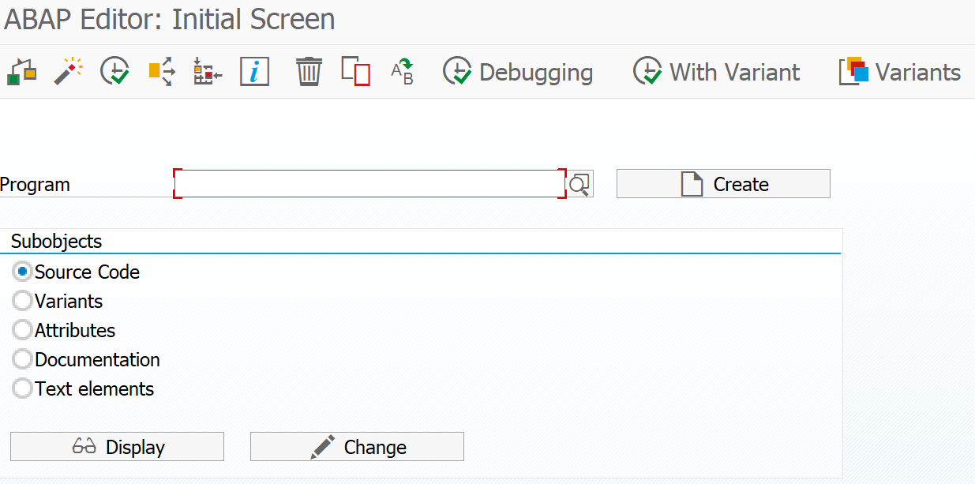
II. SAP flight example Short introduction to the SAP flight example
Created and maintained by SAP to demonstrate database operations
Contains exercise data for airline, flight connection number, flight date, airfare etc.
Report for data generation: SAPBC_DATA_GENERATOR (use Transaction SE38)
SAP trainings, examples from books build refer to the flight example

Slide 15
II. SAP flight example Table structure
Connection
Flight
Reservation
Plane
SPFLI
SFLIGHT
SBOOK
SAPLANE
MANDT
MANDT
MANDT
MANDT
CARRID
CARRID
CARRID
PLANETYPE
CONNID
CONNID
CONNID
SEATSMAX
AIRPFROM
FLDATE
FLDATE
TANKCAP
AIRPTO
SEATSMAX
BOOKID
CAP_UNIT
CITYFROM
SEATSOCC
CUSTOMID
WEIGHT
CITYTO
PRICE
LUGGWEIGH
WIE_UNIT
COUNTRYFR
CURRENCY
WUNIT
OP_SPEED
COUNTRYTO
PLANETYPE
CANCELLED
SPEED_UNIT
…
…
…
…

Slide 16
Now you know about the data dictionary and the SAP flight example.
To consolidate your knowledge, you can do task 1 and 2 of the Database Access exercise.

Slide 17
III. SAP OpenSQL OpenSQL vs. Native SQL
Independent from database
Application Server
Database Server
ABAP-Interpreter
DB-Interface
SQL-Database
Select * from
OpenSQL
Native SQL
DB data
DB data
Exec SQL.
Select * from
End Exec.
Data
Native SQL
DB data

Slide 18
III. SAP OpenSQL Instructions (examples)
Select:
Aggregation:
Joins:
SELECT
*
FROM
table
INTO
structure
WHERE
condition
SELECT
SINGLE
FIELD
view
internal table
SELECT MAX
SELECT MIN
SELECT COUNT
table1 INNER JOIN table2
table1 LEFT OUTER JOIN table2

Slide 19
III. SAP OpenSQL Procedure for database access
General:
Be specific to decrease the load on the database
Access to database takes 10,000 time longer than access to buffers
Avoid table scans, use indexes
Procedure:
Be specific to decrease the load on the database
Read database data into internal tables
Internal tables are tables for holding data during runtime
Change data per row
Use workareas to hold one row of the table and change data in the workarea
Write changes back to database

Slide 20
III. SAP OpenSQL Types of database changes
Modify instruction:
MODIFY <dbtable> [CLIENT SPECIFIED] FROM <workarea>.
MODIFY <dbtable> [CLIENT SPECIFIED] FROM TABLE <internaltable>
Modify = Update – the command updates the database table if the database table already contains dataset
Modify = Insert – the command inserts new datasets into the database table
Delete instruction:
DELETE FROM <dbtable> WHERE [SQL statement].

Slide 21

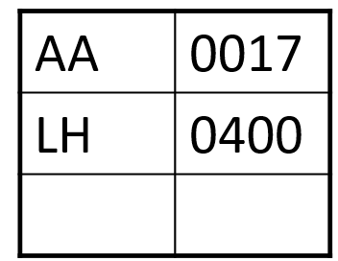
III. SAP OpenSQL Procedure for database access
wa_spfli
Workarea
(one row)
Use the workarea to modify one data set
it_spfli
Internal table
(selected content)
Use the internal table to store the selected database content temporarily
Internal tables are deleted after program is finished
Database
Database table
(whole content)
Use the database to read/write data

Slide 22
III. SAP OpenSQL Indexes
General:
Indexes (secondary keys) can further improve the efficiency of search operations
Index: database object that can be defined for an individual column or a series of columns in a database table
Consists of one or more inversion lists (set of non-overlapping numeric ranges)
Indexes provide access to the table data via non-key columns
Necessary if the table is frequently used without taking advantage of the primary key

Slide 23
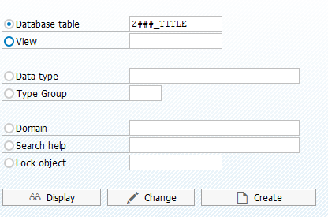
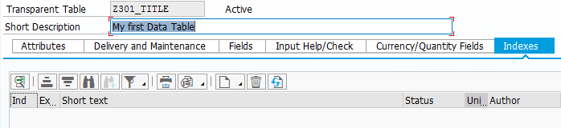
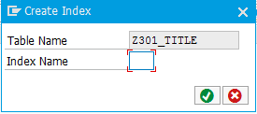
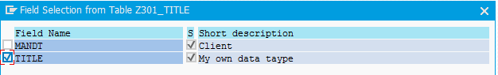
III. SAP OpenSQL Create index (secondary key)
Step-by-Step:
Go to SE11, enter required Database, press change
Switch to the tab indexes, click create -> create index
Choose an index name
Select the fields the index should comprise

Slide 24

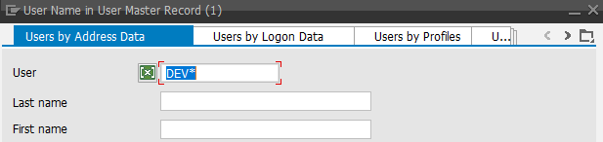

III. SAP OpenSQL Entry Help
Entry help (F4) lists possible entries for an entry field
F4 help uses a table in the background
Predefined entry help for a table
Can be used by either pressing the button or pressing F4

Slide 25
Now you know about SAP OpenSQL.
To consolidate your knowledge, you can do task 3 and 4 of the Database Access exercise.

Slide 26
Check your knowledge

Slide 27
Check your knowledge
You can use the data dictionary to add entries to a table manually.
□ True □ False
Explain a reason not to use Native-SQL in favor of OpenSQL (think about an example scenario where Native-SQL is problematic).
Why is the database data read into internal tables
□ To save memory □ To accelerate the application □ To avoid high disk usage

Slide 28
Solution

Slide 29
Check your knowledge
You can use the data dictionary to add entries to a table manually.
□ True ☒ False
Explain a reason not to use Native-SQL in favor of OpenSQL (think about an example scenario where Native-SQL is problematic).
See slide 13 - OpenSQL vs. Native SQL
Why is the database data read into internal tables
□ To save memory ☒ To accelerate the application □ To avoid high disk usage

